Slide 1
Randomized Algorithms

Slide 2
Randomized Algorithms (Probabilistic Algorithm)
Flip a coin, when you do not know how to make a decision!
QuickSort with randomly picked up pivot is an example.
The internal working of the algorithm is never same even for the same input. Randomized algorithms may have different output for same input.
Sensitive to the embedded random number generating algorithms. Computers work with pseudo-random number generators, dependent on the key, fed at the initiation of a generator. Typically clock digits (least significant ones) are used as a key.
There are powerful randomized algorithms that can non-deterministically solve some problems more efficiently. Examples: Genetic Algorithms, or GSAT. Often these algorithms do not guarantee any solution, or are “incomplete” algorithms!

Slide 3
Two Types of Random Numbers
Pseudorandom numbers are numbers that appear random.
They are obtained in a deterministic.
They are repeatable.
They are predictable.
Truly random numbers are generated in non-deterministic ways.
They are not predictable.
They are not repeatable.

Slide 4
Random Number Generators
Random numbers are generated in a sequence, by a called routine and the sequence is supposed to be aperiodic - never repeats.
A typical method: x(i+1) = Ax(i) mod M, where M is a prime number and A is an integer.
x(i) should never become 0, hence mod is taken with a prime number M. With the proper choice of A, the sequence will repeat itself after M-1 elements in the sequence (bad choice of A causes a shorter period): hence, they are called pseudo-random numbers.
Example, M=11, A=7, and x(0)=1 (the seed), the sequence is 7,5,2,3,10,4,6,9,8,1, 7,5,2,....
A large prime number should be used to avoid repetition.
The seed should not be zero. It could be the least significant digits of the clock.

Slide 5
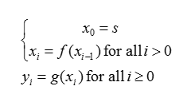
Psuedo-Random Number Generators
We really don’t have truly random random number generators.
To generate psuedo-random sequence, let s∈X be a seed. This seed defines a sequence
Where, f : X→X and g: X→Y, X is a sufficiently large set and Y is the domain of pseudorandom values to be generated. y_{i} is the pseudorandom sequence

Slide 6
Randomly Permuting Arrays
Many randomized algorithms randomize the input by permuting the given input array.
We assume that we are given an array B which, without loss of generality, contains the elements 1 through n. Our goal is to produce a random permutation of the array.
One common method is to assign each element B[i] of the array a random priority P[i], and then sort the elements of B according to these priorities.
PermuteBySorting(B)
n ← length[B]
for i ← 1 to n do
P[i] ← Randomi(1, n³)
sort B, using P as sort keys
return B
A better method for generating a random permutation is to permute the given array in place.
The procedure RandomizeInPlace does so in O(n) time. In iteration i, the element B[i] is chosen randomly from among elements B[i] through B[n]. Subsequent to iteration i, B[i] is never altered.
RandomizeInPlace(B)
n ← length[B]
for i ←1 to n do
swap B[i] ↔B[randomi(i,n)]

Slide 7
Randomized Algorithm
An algorithm is randomized algorithm if its behavior is determined not only by its input but also by values produced by a random-number generator.
Randomization and probabilistic analysis are themes that cut across many areas of computer science, especially algorithm design.

Slide 8
Deterministic vs. Randomized Algorithm
Deterministic Algorithm: Identical behavior for different runs for a given input.
Randomized Algorithm : Behavior is generally different for different runs for a given input

Slide 9
Thoughts
For some problems, it is better to randomly choose, instead of taking the time to take the best choice.
Factors:
How much difference are between random choices and the best choice
How long does it take to calculate the best choice
Probabilistic algorithms might return different answers on the same problem instance

Slide 10
Randomized Algorithms Characteristics and Categories
Main characteristic:
The same algorithm may behave differently when it is applied twice to the same Instance
Execution time and even the result obtained may vary considerably from one use to the next
Major open questions in field:
Does every efficient randomized algorithm have an efficient deterministic counterpart?
How to decrease the probability of making errors?
Randomized algorithms fall into four main design categories:
1. Numerical probabilistic algorithms
2. Randomizations of deterministic algorithms(Sherwood algorithms)
3. Las Vegas algorithms
4. Monte Carlo algorithms

Slide 11
Las Vegas Algorithms
Always produce the same (correct) output for the same input
Execution time depends on the randomizer
Goal is often to minimize the odds of encountering worst case performance
Example: Randomized quick sort

Slide 12
Monte Carlo Algorithms
Occasionally gives an incorrect answer
The probability of an incorrect answer is required to be low.
Typically does not display variation in execution time for a particular input
Goal is to provide an answer that has a high likelihood of being correct in a reasonable time
Example: Determining primality of an integer with several hundred decimal digits.

Slide 13
Sherwood Algorithms
Always finds the correct answer and is as reliable as a deterministic algorithm.
Used to speed up the processing of bad cases, when a deterministic algorithm works considerable faster in average cases than in the worst case.
Tend to cause the expected behavior of each input to approach the average behavior of the deterministic algorithm so that A_{exp}(n) is approximately equal to A(n).
Thus, have the most potential of being useful when the average complexity A(n) of the deterministic algorithm is significantly smaller than the worst-case complexity W(n). Then a suitable randomization usually results in a W_{exp}(n) that is also significantly smaller than W(n).

Slide 14
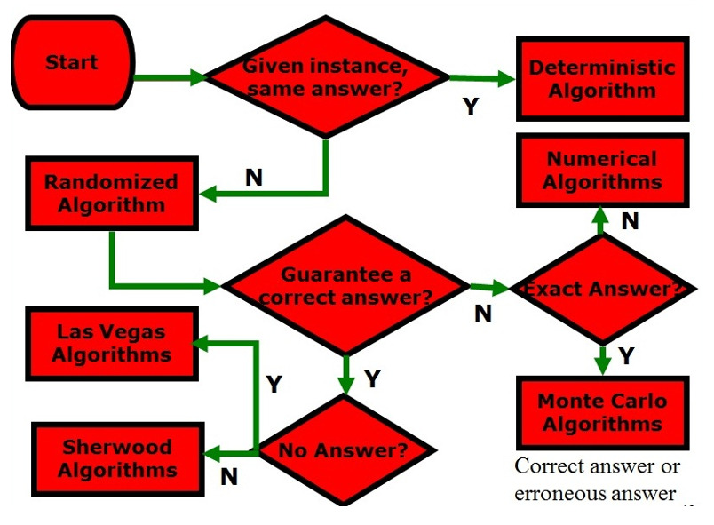

Slide 15
Illustration
How a randomized algorithm would answer the question “When did the WWII begin?”
Numerical algorithm (5 calls):
{1940±2; 1939±2; 1937±2;1915±2; 1942±2} in a confidence interval with probability p%
Monte Carlo algorithm (10 calls):
{1939; 1939; 1939; 1941;1939; 1939; 1939; 1939; 56BC; 1939} ← is correct with probability p%
Las Vegas algorithm (10 calls): {1939; 1939; Fail!;1939;1939; 1939; 1939; 1939; Fail !; 1939} ← may fail with probability ε%
Sherwood algorithm (10 calls): {1939; 1939; 1939;1939;1939; 1939; 1939; 1939; 1939; 1939} ← success 100%

Slide 16
Example
The hiring problem
Suppose that you need to hire a new office assistant. Your previous attempts at hiring have been unsuccessful, you are committed to having, at all times, the best possible person for the job. Therefore, you decide that, after interviewing each applicant, if that applicant is better qualified than the current office assistant, you will fire the current office assistant and hire the new applicant. You are willing to pay the resulting price of this strategy, but you wish to estimate what that price will be.
HireAssistant(n)
best ← 0 // candidate 0 is a least-qualified dummy candidate
for i ← 1 to n do
interview candidate i
if candidate i is better than candidate best then
best ← i
hire candidate i
Interviewing has a low cost, say c_{i}, whereas hiring is expensive, costing c_{h}. Let m be the number of people hired. Then the total cost associated with this algorithm is O(nc_{i} + mc_{h}).
Worst-case /Best-case analysis

Slide 17
Randomized Hire Algorithm
RandomizedHireAssistant(n)
randomly permute the list of candidates
best ← 0 //candidate 0 is a least-qualified dummy candidate
for i ← 1 to n do
interview candidate i
if candidate i is better than candidate best then
best ← i
hire candidate i

Slide 18
Randomized Sampling
Consider the problem of selecting a sample of m elements randomly from a set of n elements,where m<n. For simplicity, we will assume that the elements are positive integers between 1 and n. Namely
Input: Two positive integers m,n with m<n.
Output: An array a[1..m] of m distinct positive integers selected randomly from the set {1,2,…,n}.

Slide 19
Selection Method
Consider the following selection method. First mark all the n elements as unselected. Next, repeat the following step until exactly m elements have been selected. Generate a random number r between 1and n. If r is marked unselected,then mark it selected and add it to the sample. This method is described more precisely in Algorithm RandomizedSampling. Where, s[1..n] is a boolean array indicating whether an integer has been selected.

Slide 20
Random Sampling Algorithm
RandomSampling(s,m)
for i←1 to n do
s[i]←false
k ← 0
while k<m do
r ← Randomi(1,n)
if not s[r] then
k ← k+1
a[k] ← r
s[r] ← true

Slide 21
What is Monte Carlo Analysis?
It is a tool for combining distributions, and thereby propagating more than just summary statistics
It uses random number generation, rather than analytic calculations
It is increasingly popular due to high speed personal computers

Slide 22
Why Perform Monte Carlo Analysis?
Combining distributions
With more than two distributions, solving analytically is very difficult
Simple calculations lose information
Mean × mean = mean
95% %ile × 95%ile ≠ 95%ile!
Gets “worse” with 3 or more distributions

Slide 23
Monte Carlo Analysis
Takes an equation
example: Risk = probability × consequence
Instead of simple numbers, draws randomly from defined distributions
Multiplies the two, stores the answer
Repeats this over and over and over…
Then the set of results is displayed as a new, combined distribution

